Slide 1
E-Commerce
Forecasting
By
AJAY V
18/10/24

Slide 2
PROBLEM STATEMENT
ElecKart is an e-commerce firm based out of Ontario, Canada specialising in electronic products. Over the last one year, they had spent a significant amount of money on marketing.
Occasionally, they had also offered big-ticket promotions (similar to the Big Billion Day). They are about to create a marketing budget for the next year, which includes spending on commercials, online campaigns, and pricing & promotion strategies.
The CFO feels that the money spent over the last 12 months on marketing was not sufficiently impactful, and, that they can either cut on the budget or reallocate it optimally across marketing levers to improve the revenue response

Slide 3
OBJECTIVE:
The objective of this project is to optimize the marketing budget of an e-commerce firm by analyzing order-level data. Through exploratory data analysis (EDA) and predictive modeling,
The goal is to identify trends, key performance indicators (KPIs), and opportunities for more efficient resource allocation. By focusing on three specific product subcategories—
camera accessories
home audio, and
gaming accessories—
the project aims to maximize Gross Merchandise Value (GMV) while minimizing wasted advertising spend.
Ultimately, the project seeks to provide actionable insights and recommendations for improving the firm's marketing strategy, leading to better profitability and enhanced customer engagement.

Slide 4
UNDERSTANDING DATA
1. Main Consumer File with Order Details at a daily basis
2. Media Investment File with amount invested in each advertising medium for the past year.
3. Sale Calendar File showing the dates from the past year where there was a promotional offer
4. NPS Score showing Net Promoter Score(Voice of Customer) and company stock value for last year
5. Weather File having detail of weather Reports from last year in the state of ‘Ontario Canada’

Slide 5
Cleaning Data and Data Preparation
1. Handling Incorrect values in some columns
- Imputing "\N" value in deliverybdays & deliverycdays by 0
- Treating incorrect GMV values (where gmv > product_mrp * units) by imputing the faulty MRP values with GMV/units
- Handling large values(0.3%) for product_procurement_sla by dropping them
2. De-Duplication Of Data:
- Seen that there are around 99283 (6.33%) rows that are duplicates. We went ahead and dropped them
3. Treating Null Values and Whitespaces:
- We first converted these whitespaces to NaNs and the dropped these values.
4. Dropping Insignificant Columns
- Dropping Columns with Single Unique Value (as it doesn’t add any information to the analysis)

Slide 6
1. Outlier Treatment:
- For the variables - 'SLA', 'deliverybdays', 'deliverybdays', 'gmv', 'product_mrp', 'list_price' where outliers are present, we CAPPED the values above 99 percentile to the value corresponding to 99 percentile
- Thus the outliers couldn’t affect the predictive model while at the same time there was enough data to build a generalizable model.
2. Selecting One Year Data:
- Selecting 1 Year Data from July, 2015 – June, 2016. In the process, 592 records were dropped.
3. Converting Categorical Features to Numerical Form:
- Binary encoding for categorical variable with 2 levels
- One Hot Encoding for categorical variable with multiple levels by creating dummy variables

Slide 7
4. Additional Data Preparation For Model Building:
- Merging Order dataset with all other secondary dataframes
- Extracting 3 separate dataframes for 3 product subcategories - camera accessory, home audio and gaming accessory
- Roll Up daily Order Data to Weekly Level by aggregating the numeric variables based on Week#
- Train Test Split followed by Scaling and dividing the master data frames into train and test datasets for all 3 product subcategories

Slide 8
EDA
Data Overview
Dataset Description: 1.6 million rows of order-level data with 20 columns, including order details, GMV, product categories, customer information, and delivery times.
Objective: To understand the distribution of key variables, identify any trends or anomalies, and set a foundation for model building.

Slide 9
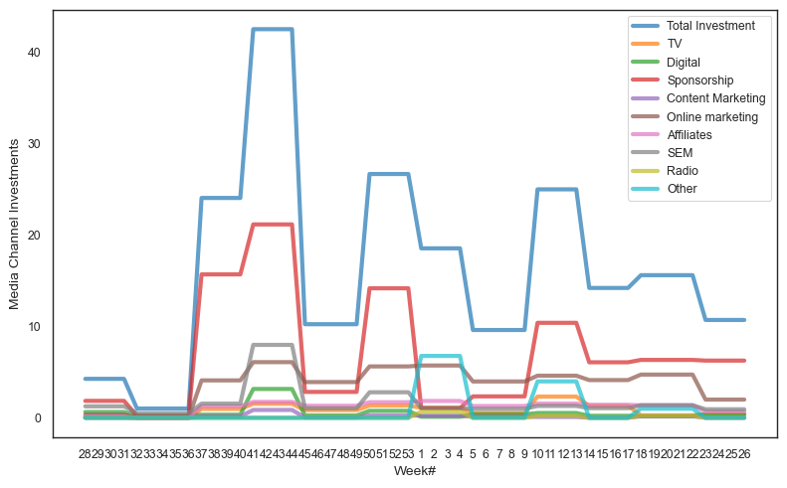
Media Channel Investment vs. Week of the Year:
Advertising investment peaks during specific weeks of the year, particularly around major shopping events like Black Friday, Christmas, and New Year's sales.
Week 45 to 52 (end of year) sees a substantial increase in marketing spend as companies prepare for holiday promotions.

Slide 10
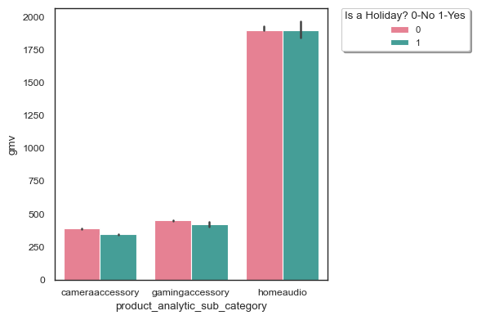
- The average(median) revenue/gmv for 3 product sub categories from holiday and non-holiday days are almost the same!
- This implies Holiday or no holiday, it doesn't affect the sales and revenue much.

Slide 11
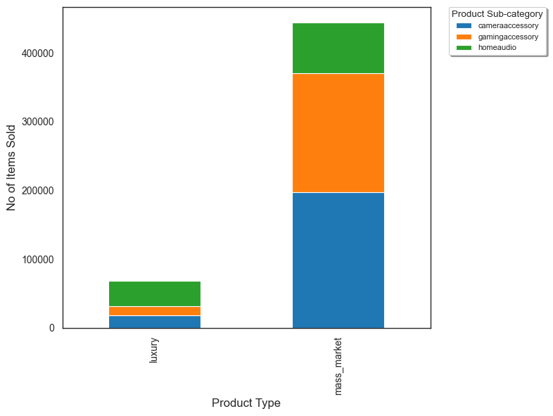
- Most of the units sold belonged to the mass market category.
- Among mass market products sold, Camera and Gaming Accessories related products were sold the most.
- Home Audio products were the most popular among the luxury products sold

Slide 12
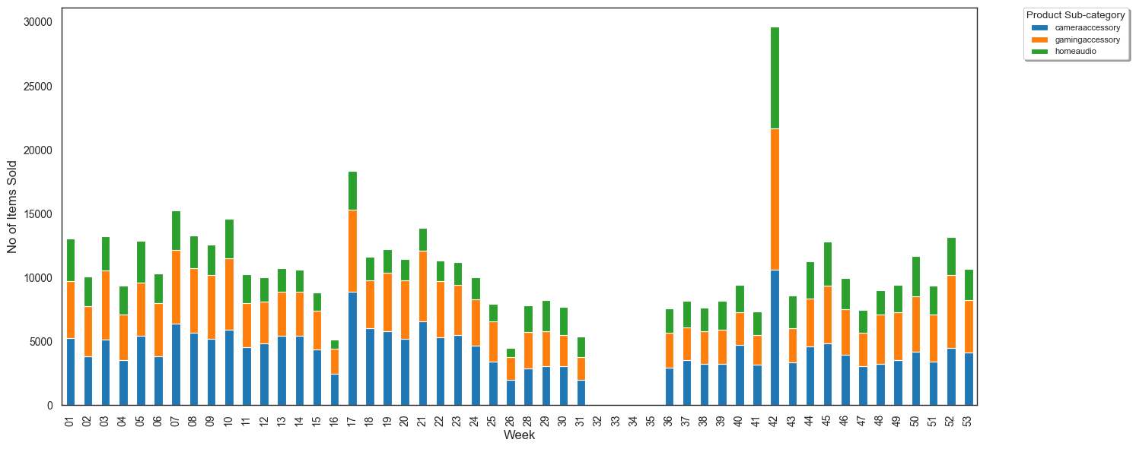
The sale on the `42nd week (Thanksgiving week)` is maximum.
Overall, October has seen most no of items being sold.

Slide 13
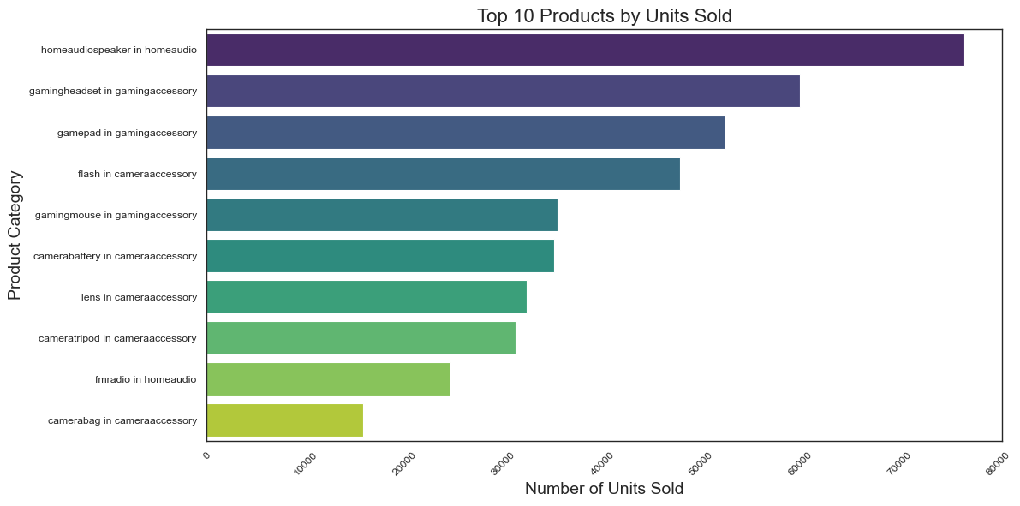
homeaudiospeaker in homeaudio the most no of sales followed by `gamingheaddio` hset & gamepad in gamingaccessory`

Slide 14
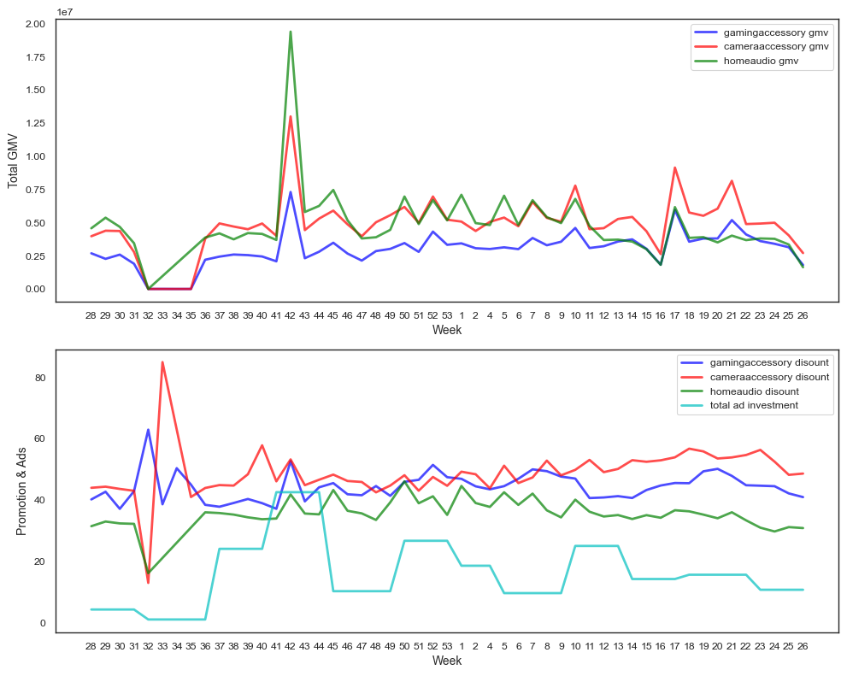
For the week# 42 (during Thanksgiving)`, all the graphs show a steep rise. Revenue increased becuase of both higher discount% and increased Ad Investment.
- For the `week 32(August)`, Revenue generated was the lowest from all 3 product subcategories. This can be observed as a direct relation to minimum amount of total investment in Ads.

Slide 15
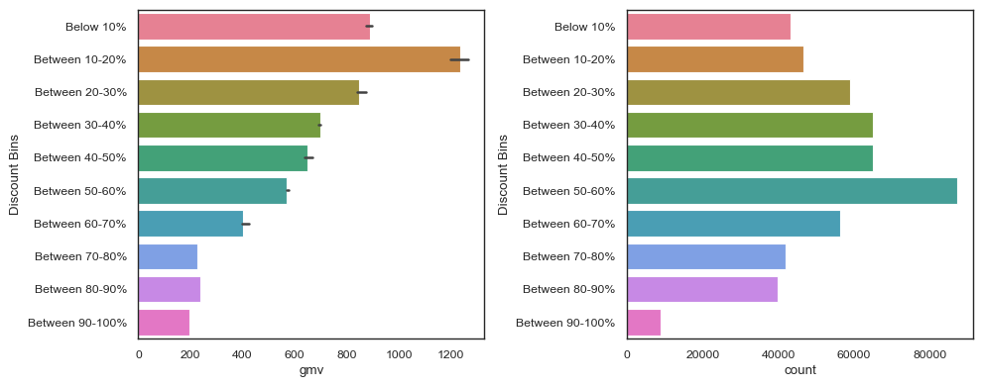
Median Revenue is maximum when Average discount% is between 10-20%. But beyond that, average revenue slowly starts to decline.
- The sales on the other hand shows a steady increase with increase in Discount percentage till it peaks at 50-60% after which it starts to fall again.
- This shows that at higher discount, although the sales are good, the revenue collapses signifying a loss for the company. An average discount of 10-20% is the most profitable for the company.

Slide 16
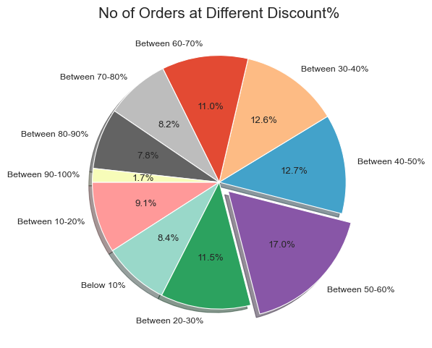
Most of the sales take place when Discount% is between 50-60%.

Slide 17
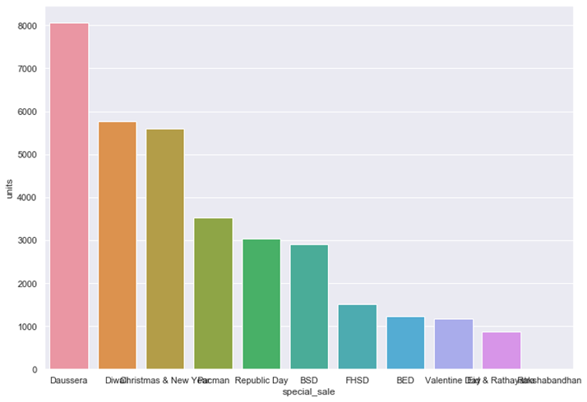
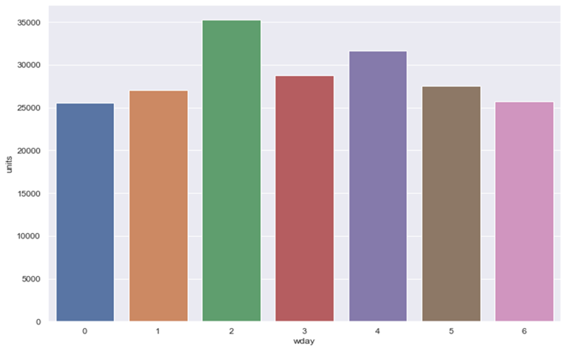
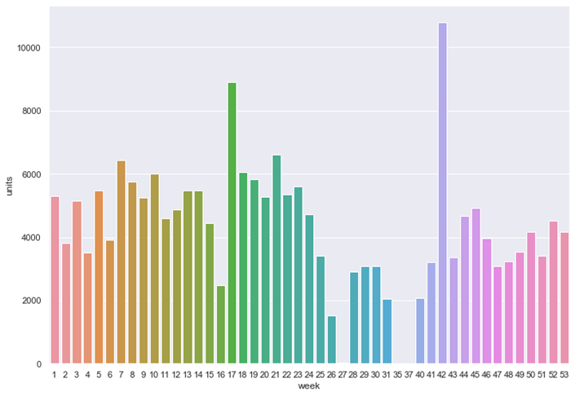
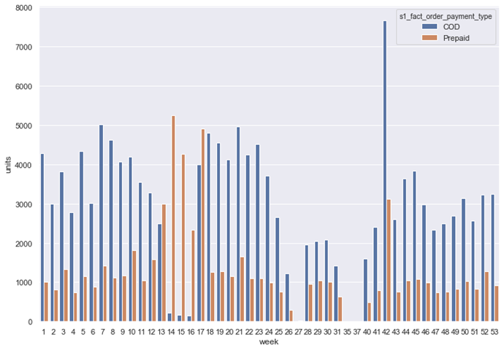
CAMERA ACCESSORY

Slide 18
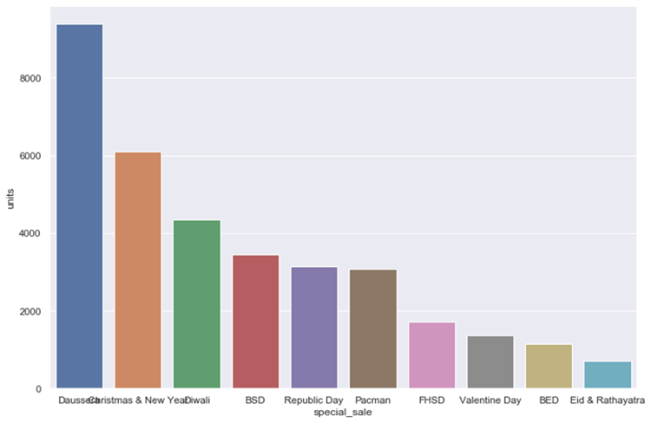
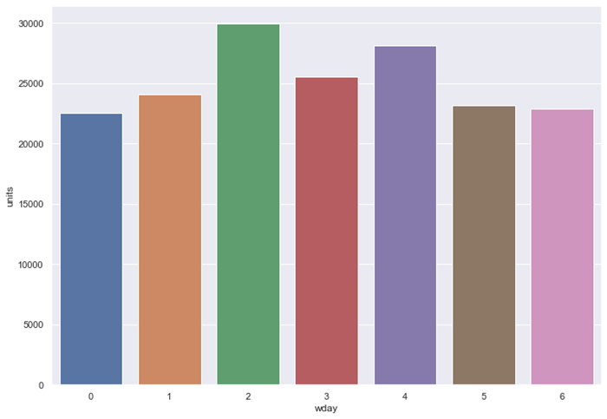
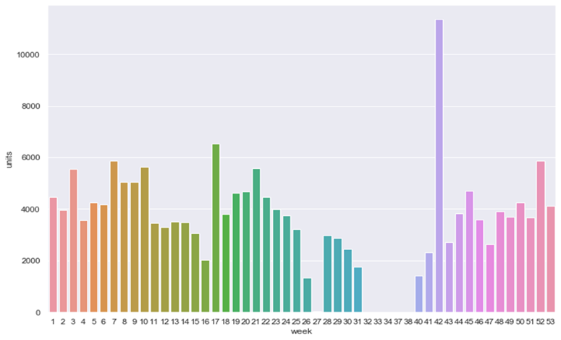
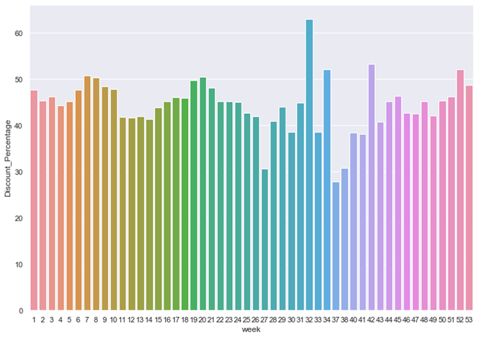
GAMING ACCESSORY

Slide 19
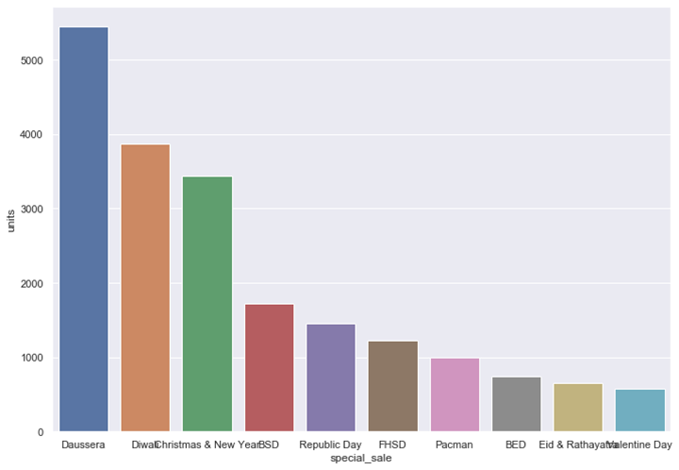
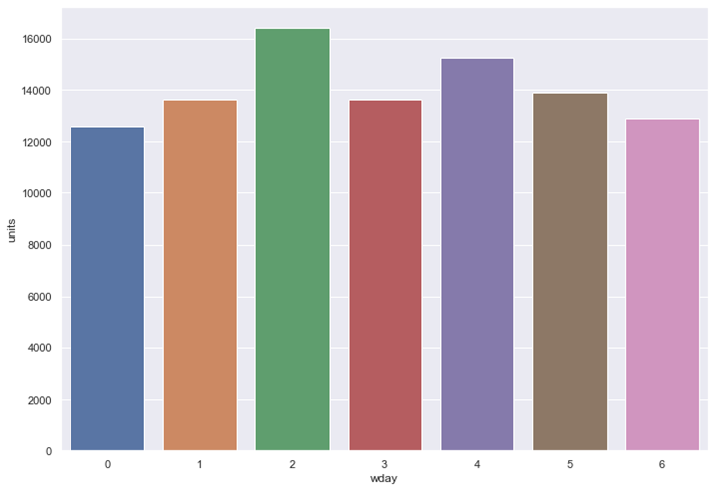
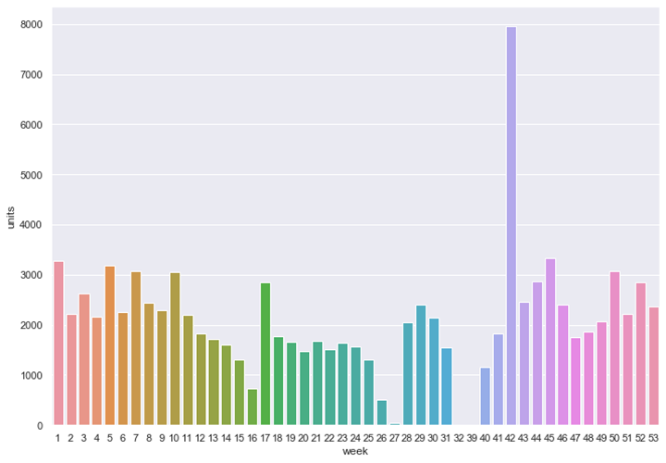
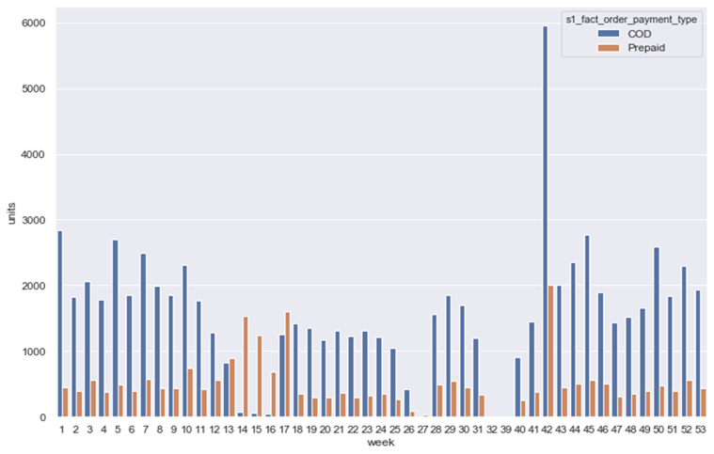
HOUSE AUDIOS

Slide 20
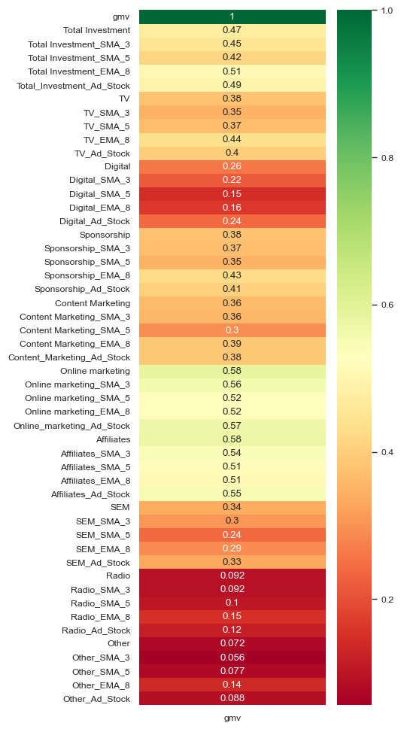
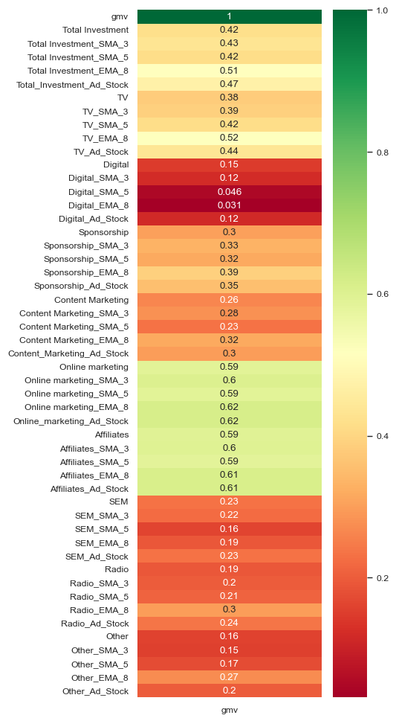
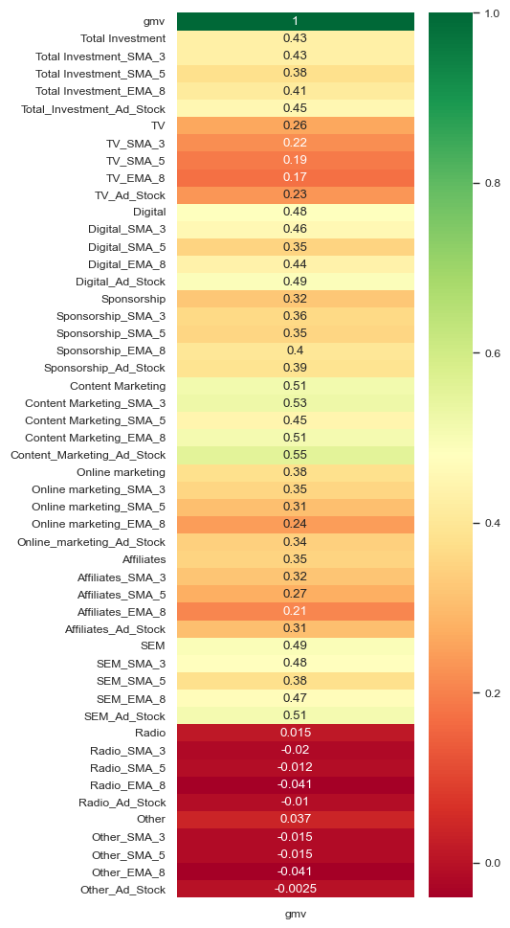
CAMERA ACCESSORY
GAMING ACCESSORY
HOUSE AUDIOS

Slide 21
Data Preparation for Machine Learning Model:
Check for Null Values:
Begin by checking the dataset for missing values (nulls) in all columns.
Drop the Week Column:
Remove the Week column since it is a row identifier and does not contribute to the prediction of revenue (GMV).
Train-Test Split:
Target Variable: The target variable for prediction is gmv (Gross Merchandise Value).
Features: Use all other columns (except Week) as features.
Split the dataset into training and testing sets, typically using an 80/20 or 70/30 ratio for training and testing.
Apply Standard Scaler:
Standardize the features using StandardScaler to ensure all features are on the same scale, especially important for linear regression.

Slide 22
Model Building:
Train Basic Linear Regression Model:
Fit a basic Linear Regression model using the training data (scaled features and target gmv).
Evaluate the Model's Metrics:
Calculate and evaluate common regression metrics such as:
R² Score: To assess the goodness of fit.
Root Mean Squared Error (RMSE): To measure the average error magnitude.
Mean Squared Error (MSE): To quantify the squared differences between predicted and actual values.
Mean Absolute Error (MAE): To assess the absolute differences between predicted and actual values.

Slide 23
Feature Selection and Optimization:
Feature Selection using Recursive Feature Elimination with Cross-Validation (RFECV):
Use RFECV to identify the most important features by recursively eliminating less important features.
Perform cross-validation during the feature elimination process to ensure the optimal subset of features is selected.
Evaluate Accuracy with Selected Features:
Assess the performance of the model using only the features selected by RFECV.
Calculate the same evaluation metrics (R², RMSE, MSE, MAE) to compare with the initial model.
Build a New Model Using RFECV-Selected Features:
Train a new Linear Regression model using only the features identified by RFECV.
Evaluate the New Model:
Evaluate the new model using the same metrics (R², RMSE, MSE, MAE).
Compare the performance of this refined model with the original model to determine the improvement brought by feature selection.

Slide 24
Basic Linear Regression model
 | CAMERA ACCESSORY |  | GAMING ACCESSORY |  | HOUSE AUDIOS
Metrics | Train | Test | Train | Test | Train | Test
R²Score: | 1.0 | 0.9767 | 1.0 | 0.87600 | 1.0 | 0.9924
RMSE | 4.48888 | 0.2961 | 3.06573 | 0.92102 | 9.27672 | 0.16281
MSE | 2.01497 | 0.0885 | 9.39871 | 0.84828 | 8.60575 | 0.0265
MAE | 3.29894 | 0.2041 | 2.81979 | 0.46187 | 4.84460 | 0.13712

Slide 25
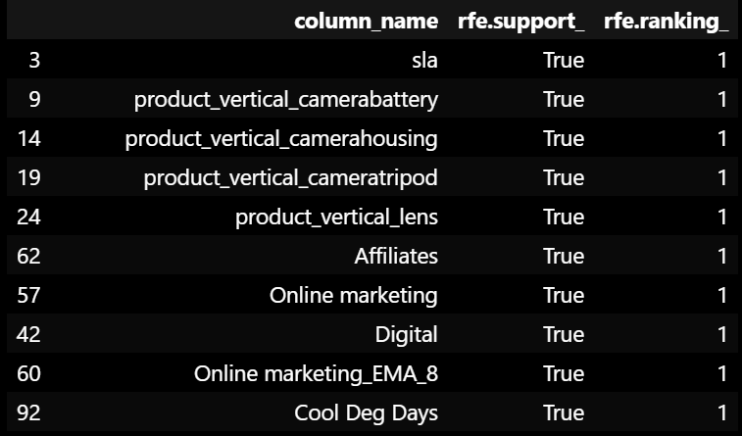
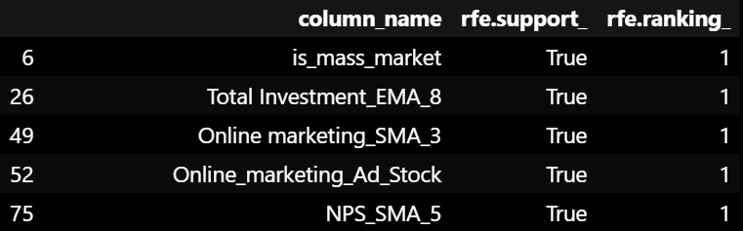
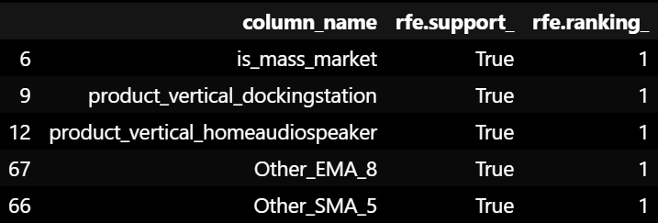
Feature selection by RFE
CAMERA ACCESSORY
GAMING ACCESSORY
HOUSE AUDIOS

Slide 26
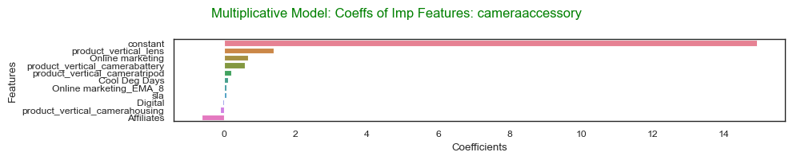
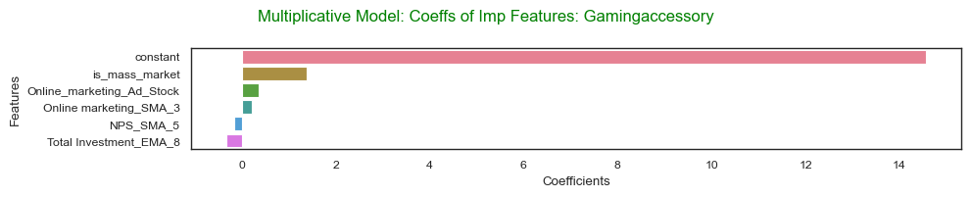
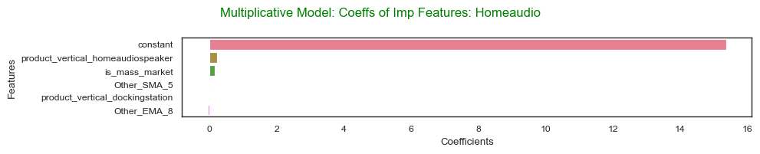

Slide 27
Linear Regression model after feature selection
 | CAMERA ACCESSORY |  | GAMING ACCESSORY |  | HOUSE AUDIOS
Metrics | Train | Test | Train | Test | Train | Test
R²Score: | 0.99813 | 0.9587 | 0.99204 | 0.97113 | 0.98908 | 0.99360
RMSE | 0.0915 | 0.3961 | 0.14415 | 0.44436 | 0.04065 | 0.14989
MSE | 0.00837 | 0.1569 | 0.02077 | 0.19745 | 0.00165 | 0.02246
MAE | 0.07225 | 0.2307 | 0.12150 | 0.28818 | 0.3188 | 0.07931

Slide 28
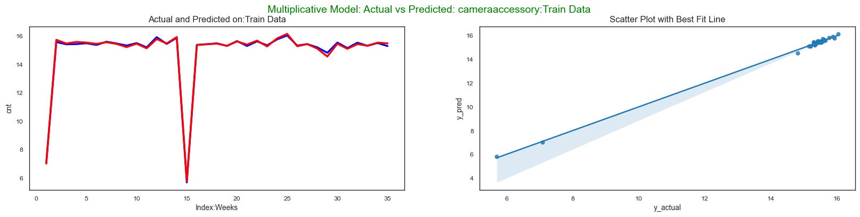
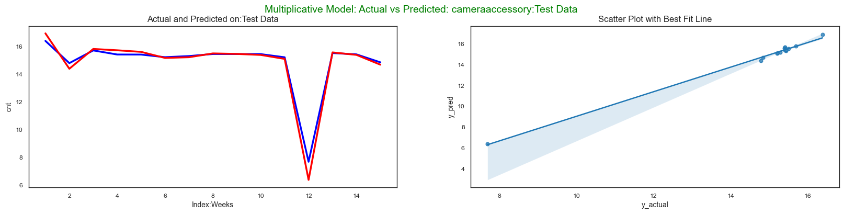

Slide 29
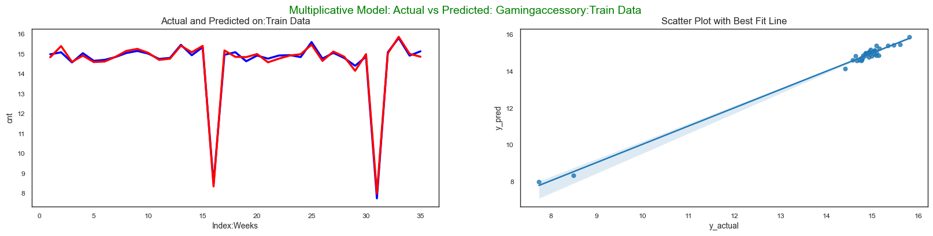
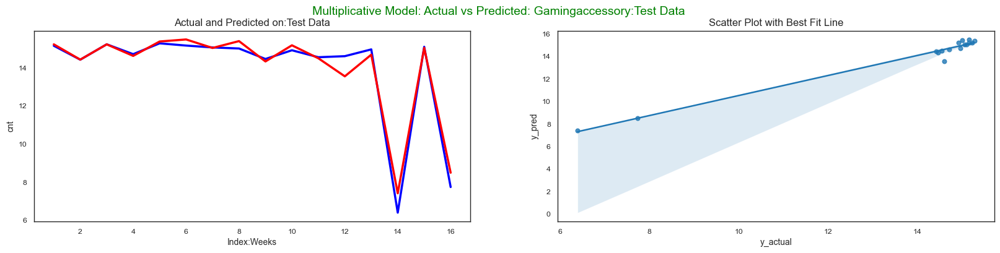

Slide 30
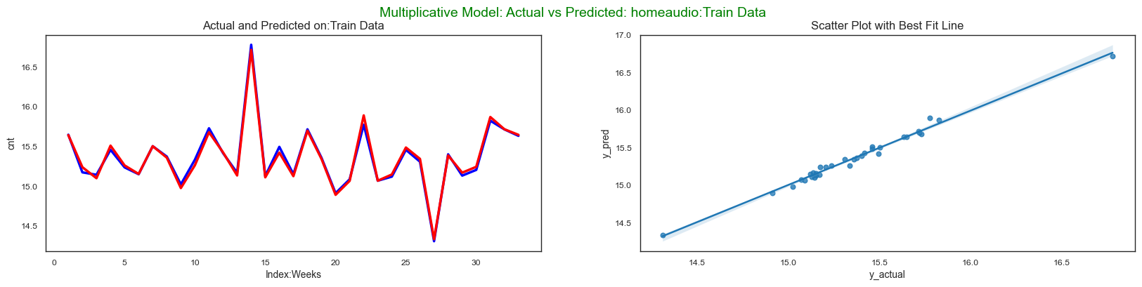
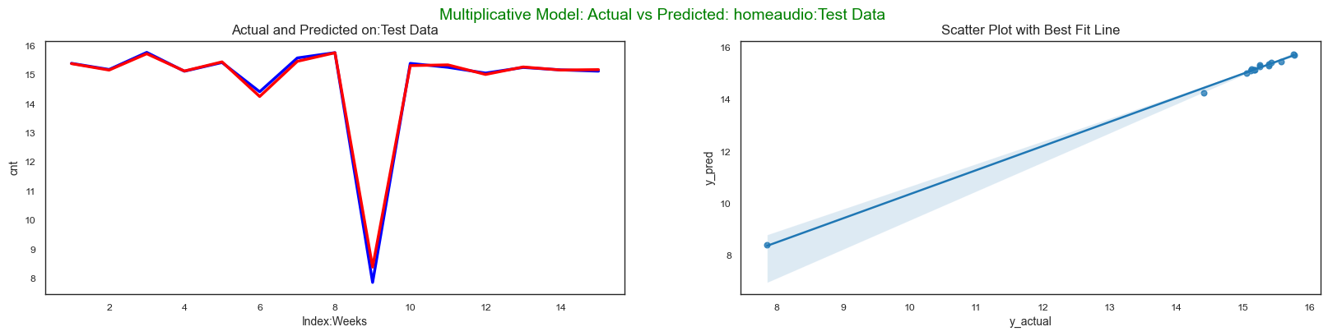

Slide 31
Camera Accessory:
1. Company should promote “Lens” and “Camera Battery” as they contribute in increasing revenue.
2. Out of the various Media Investment Channels company should focus more on “Affiliates” channels by introducing well researched and known to bring high revenue schemes. “Online Marketing” Channel on the other hand impact negatively and thus investment in that channel should be reduced.
3. “Mass market” products are better contributors to increased revenue in comparison to luxury products

Slide 32
Gaming Accessory:
1. “Gamepad”, “Gamingheadset”, “Gaming Mouse” should be promoted as they contribute in increasing revenue. On the contrary “gamingaccessorykit” results in loss.
2. Advertising spends on “Affiliates” and “TV” are known to bring positive impact on revenue.
3. “Mass market” products are better contributors to increased revenue in comparison to luxury products.
4. `Higher percentage of discounts` for this Gaming accessory category works adversely towards bringing down the revenue.

Slide 33
Home Audio:
1. ‘Home Audio Speaker’ , and ‘fmradio’ should be promoted as they contribute in increasing revenue.
2. Advertising spends on “Sponsorship” is seen to bring positive impact on revenue, while `Investment in AdStock` is seen to bring negative impact on revenue
3. “Mass market” products are better contributors to increased revenue in comparison to luxury products.

Slide 34
Thank
YOU

